Slide 1
E-RATION MANAGEMENT SYSTEM
Project Presentation
Division of Information Technology
Cochin University College of Engineering Kuttanad
Presented by: Niwana C Tom – 41 -24102802
Parvathi Raj – 42 24102379
Reema Faroon K -43 24102346
Ridhin Raj K M -44 – 24102766
Academic Year: 2026

Slide 2
Introduction
E-Ration Management System is a web-based platform for digital management of ration services.
It provides separate role-based access for Admin, Shopkeeper and Beneficiary.
The system manages registration, approval, quota, stock, ration distribution, complaints and alerts.
It helps maintain organized records and reduces manual management.
E-Ration Management System | Project
2

Slide 3
Aim
Project Aim
To develop a secure and efficient web-based system for managing beneficiaries, ration shops, quotas, stock, ration distribution and complaints in a centralized manner.
Admin
Shopkeeper
Beneficiary
Controls and verifies the system
Manages stock and distribution
Views ration services and files complaints
E-Ration Management System | i Project
3

Slide 4
Objectives
Digitize beneficiary and shopkeeper registration.
Verify and approve registrations before access.
Manage ration quotas based on card type.
Maintain shop stock and ration distribution records.
Provide beneficiaries with profile, quota, history and alert information.
Provide complaint management and warning notifications.
E-Ration Management System | Project
4

Slide 5
Scope
Authentication
Beneficiary
Login, role verification and approval status
Profile, quota, history, alerts and complaints
Shopkeeper
Admin
Stock updates and ration distribution
Dashboard, approvals, quota and item management
Inventory
Complaint & Alerts
Available, allocated and distributed stock
Complaint handling and warning notifications
E-Ration Management System | Project
5

Slide 6
Requirement Analysis
Functional Requirements
User Login – credential verification, role identification and approval checking.
Beneficiary Registration – personal, Aadhaar, ration card, shop and account details.
Shopkeeper Registration – owner, Aadhaar, shop, license and account details.
View Profile, Monthly Quota, Distribution History and Alerts.
View Shop Stock and Update Stock.
Distribute Ration and update stock after distribution.
Dashboard Management and Approve Registrations.
Manage Quota and Add New Item.
E-Ration Management System | Project
6

Slide 7
Requirement Analysis
Functional Requirements – Continued
Complaint Management – admin reviews and updates complaint status.
File Complaint – beneficiary submits a complaint against a ration shop.
Warning Alert – admin sends a warning notification to a shopkeeper.
Invalid Login Handling – displays invalid credentials or pending approval messages.
Registration details are stored with Pending Approval status until verification.
Role-based access is provided for Admin, Shopkeeper and Beneficiary.
E-Ration Management System | Project
7

Slide 8
Requirement Analysis
Non-Functional Requirements
Performance
Compatibility
Fast and responsive operation; optimized database queries; common operations targeted below 2 seconds.
Desktop, laptop, tablet and mobile support; Chrome, Firefox, Edge and Safari; XAMPP and live deployment.
Security
Reliability
Password hashing, JWT authentication, role-based access control and protection against SQL injection and unauthorized access.
Accurate quota, stock and transaction records with backup and recovery mechanisms.
Usability
User-friendly interface for beneficiaries, shopkeepers and administrators.
E-Ration Management System | Project
8

Slide 9
Modules
The system has three main modules
ADMIN MODULE
SHOPKEEPER MODULE
BENEFICIARY MODULE
• Manage dashboard statistics
• Approve / reject registrations
• Manage ration quota
• Add new ration items
• Manage complaints
• Send warning alerts
• Register as shopkeeper
• View shop stock
• Update stock
• Distribute ration
• Maintain distribution records
• Register as beneficiary
• View profile
• View monthly quota
• View distribution history
• View alerts and shop stock
• File complaints
E-Ration Management System | Project
9

Slide 10
Admin Module
Module and Functionalities
Module Overview
Provides administrative control over users, ration items, quota, complaints and system statistics.
Dashboard Management
Approve Registrations
View total users, pending approvals and pending complaints.
Verify and approve or reject beneficiary and shopkeeper registrations.
Manage Quota
Add New Item
Set ration quantity and price for different card types.
Add a new ration item with quantity, price and unit.
Complaint Management
Warning Alert
Review complaints and update their status.
Send a warning notification to a shopkeeper when required.
E-Ration Management System | Project
10

Slide 11
Shopkeeper Module
Module and Functionalities
Module Overview
Allows approved shopkeepers to manage ration shop stock and distribute ration to beneficiaries.
Shopkeeper Registration
View Shop Stock
Enter owner and shop details and submit them for admin approval.
View allocated, distributed and available quantities.
Update Stock
Distribute Ration
Add newly received stock to the shop inventory.
Record ration issued to beneficiaries.
Stock Update
Stock balance is updated after ration distribution.
E-Ration Management System | Project
11

Slide 12
Beneficiary Module
Module and Functionalities
Module Overview
Allows approved beneficiaries to access their ration information and interact with the ration shop.
Beneficiary Registration
View Profile
Enter personal and ration card details and submit for approval.
View name, ration card type, address and assigned shop.
View Monthly Quota
View Distribution History
View allocated rice, wheat, sugar, kerosene and quantities.
View previous ration collection transactions.
View Alerts & Shop Stock
File Complaint
View announcements, stock information and available shop stock.
Submit a complaint against a ration shop.
E-Ration Management System | i Project
12

Slide 13
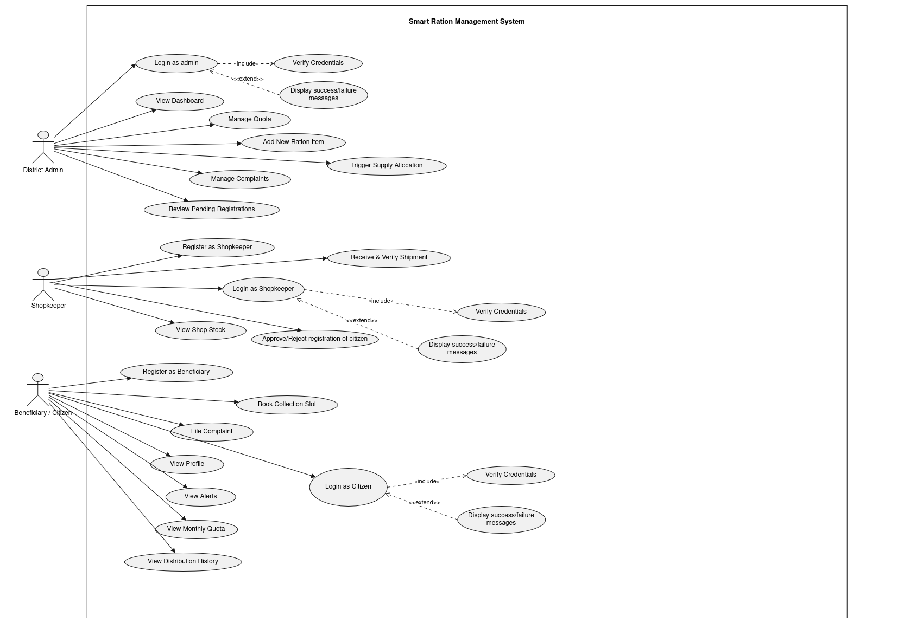
System Design – Use Case Diagram
USE CASE DIAGRAM
Insert the final Use Case Diagram here
E-Ration Management System | Project
13

Slide 14
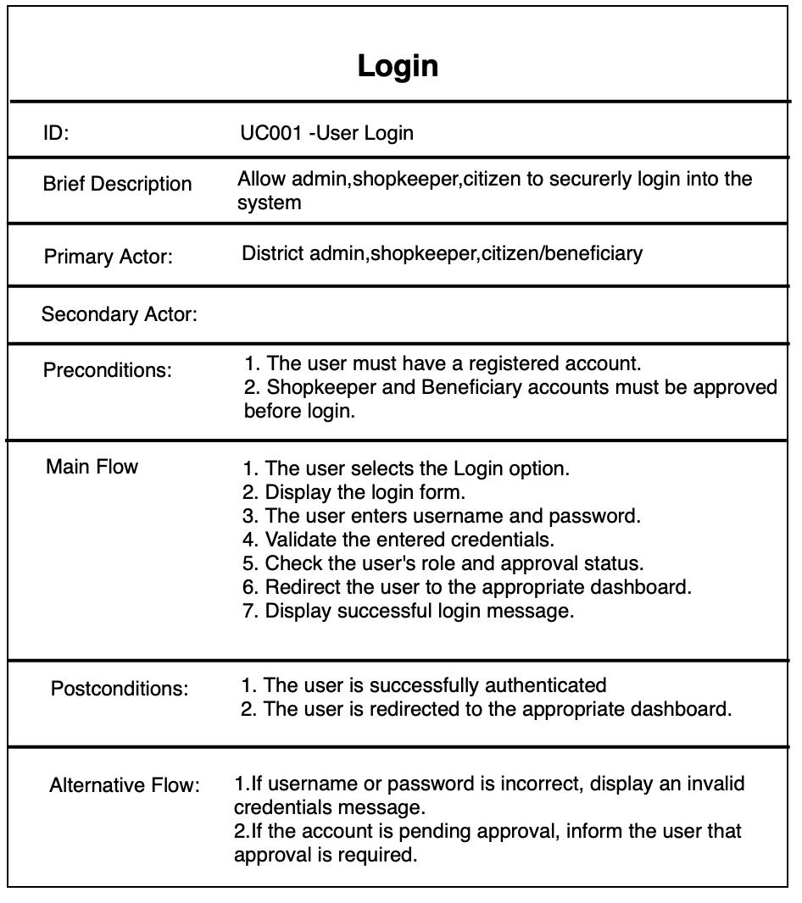
Use Case Specification
E-Ration Management System | i Project
14

Slide 15
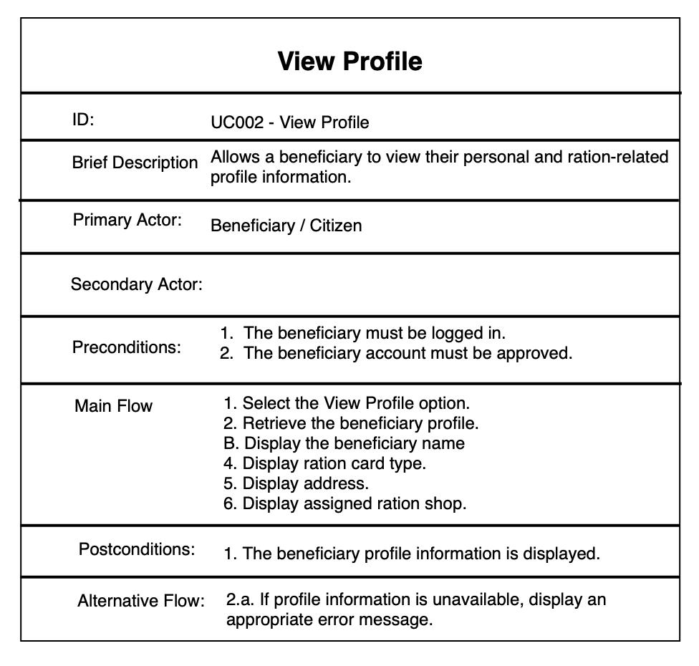
Use Case Specification
E-Ration Management System | i Project
14

Slide 16
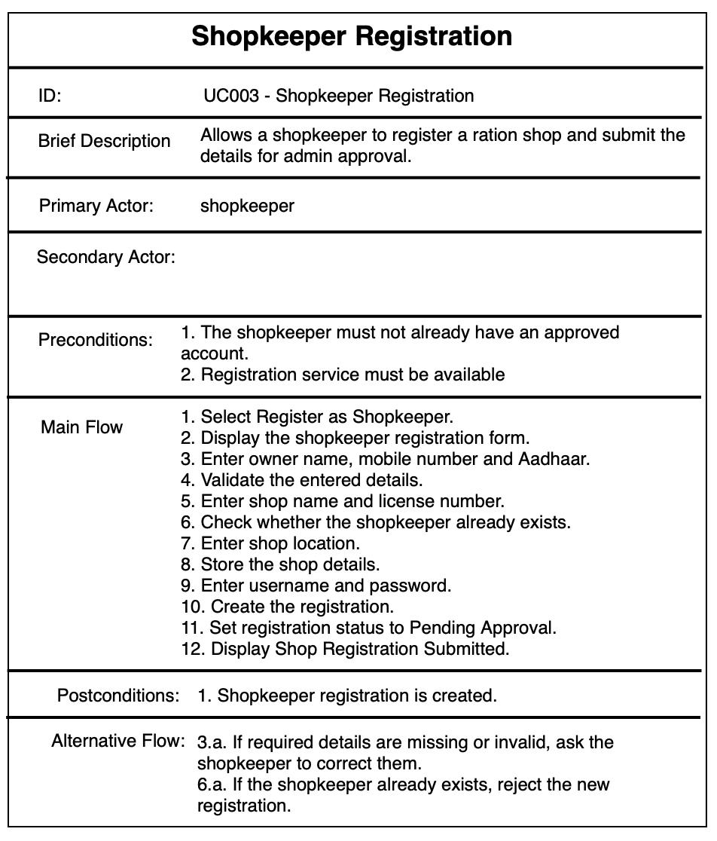
Use Case Specification
E-Ration Management System | Project
15

Slide 17
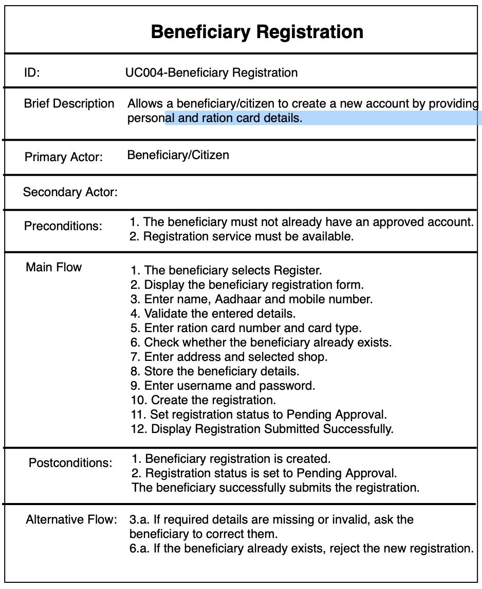
Use Case Specification
E-Ration Management System | Project
15

Slide 18
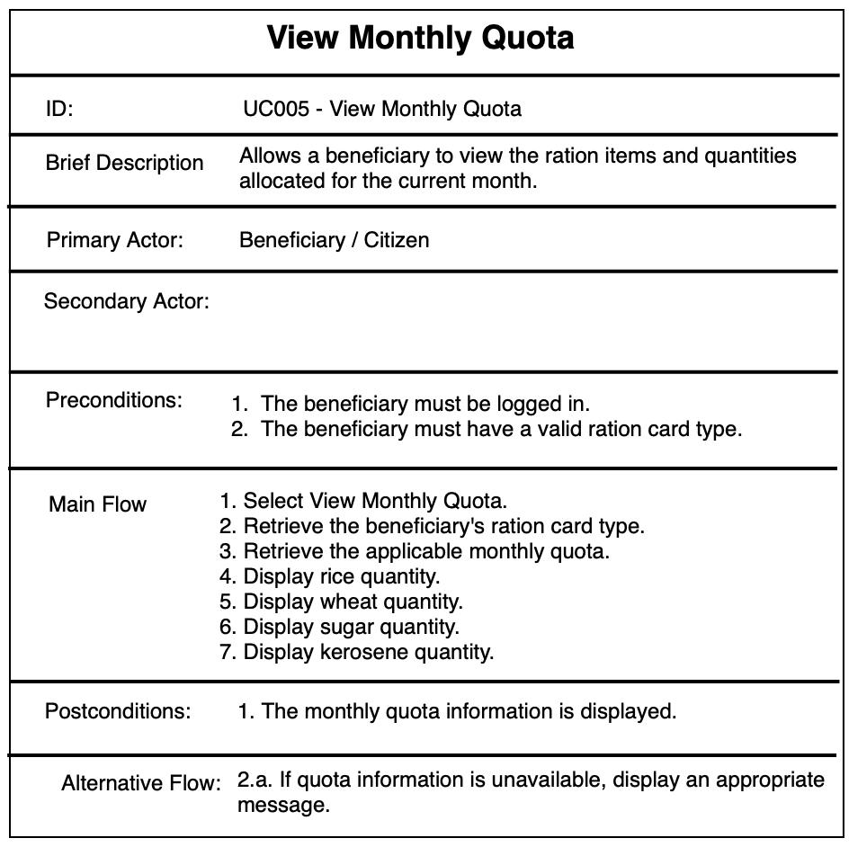
Use Case Specification
E-Ration Management System | i Project
16

Slide 19
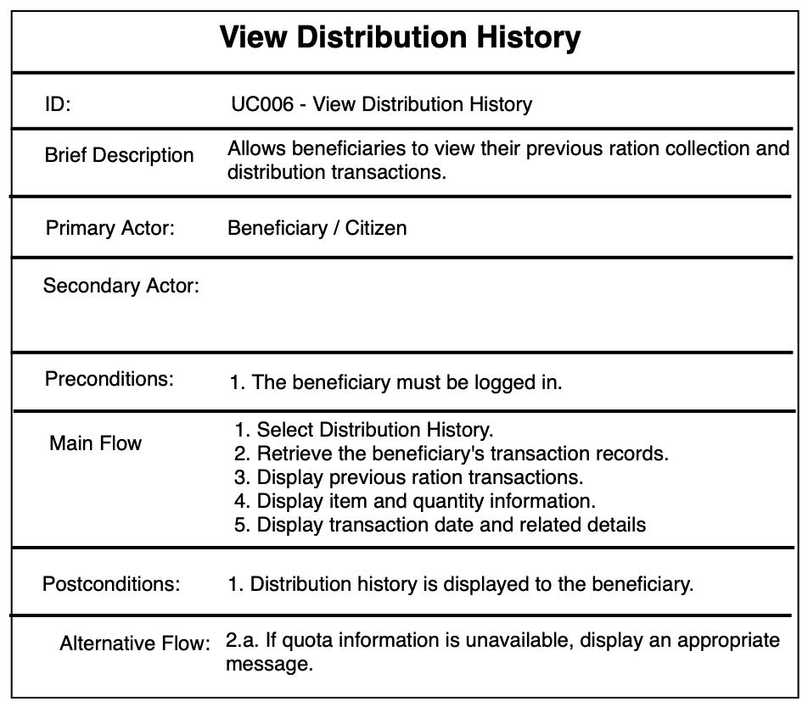
Use Case Specification
E-Ration Management System | i Project
16

Slide 20
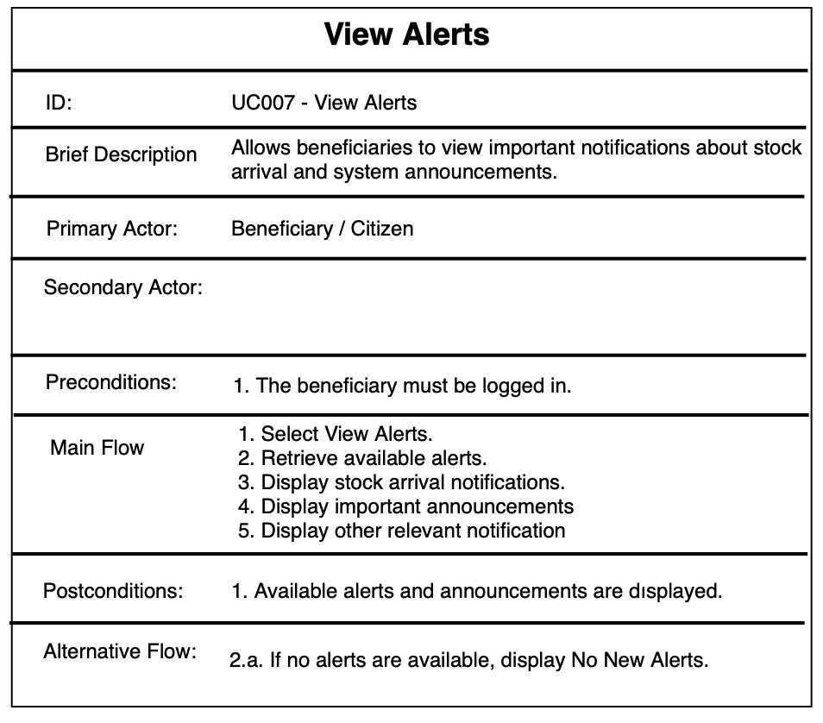
Use Case Specification
E-Ration Management System | i Project
16

Slide 21
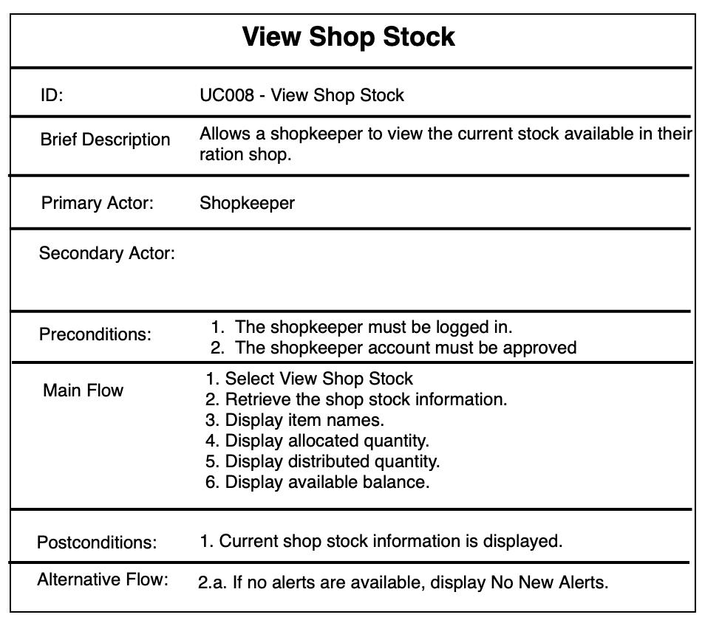
Use Case Specification
E-Ration Management System | Project
17

Slide 22
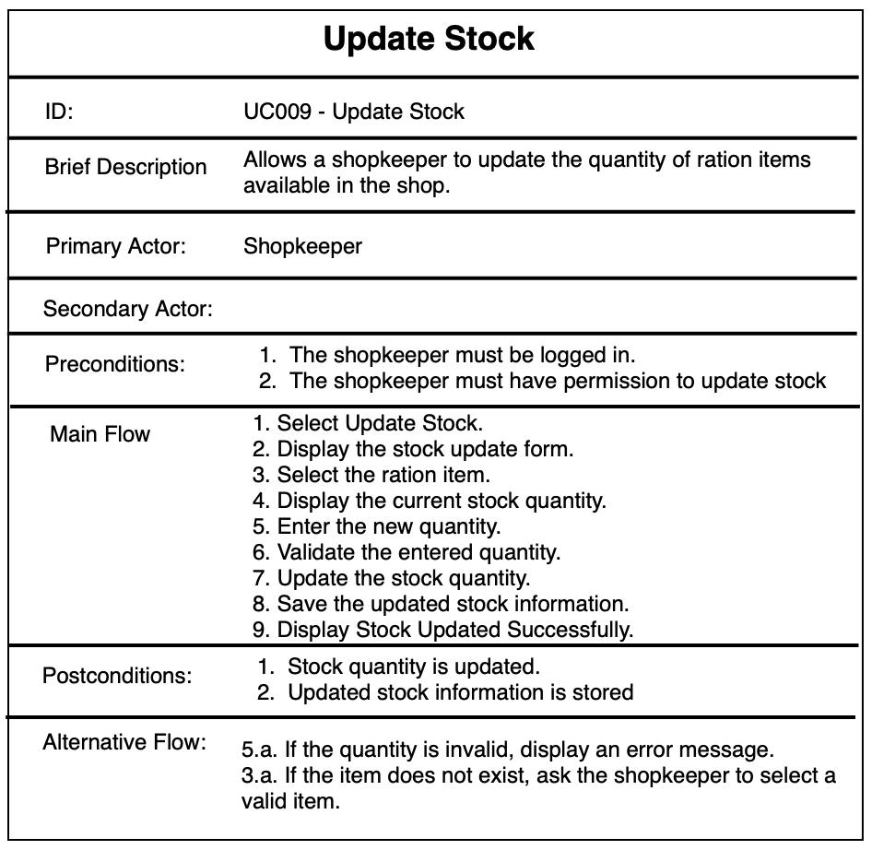
Use Case Specification
E-Ration Management System | Project
18

Slide 23
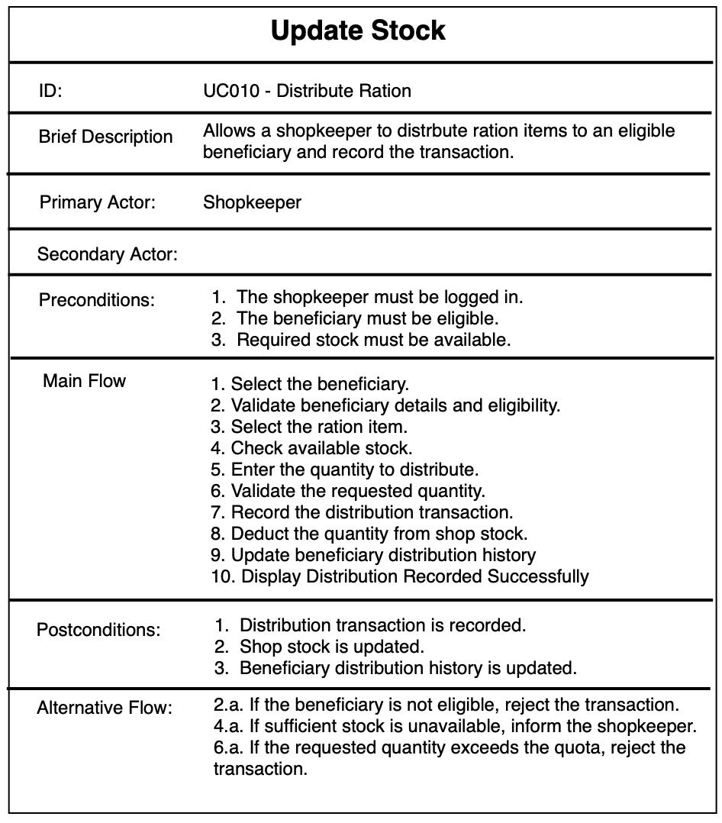
Use Case Specification
E-Ration Management System | Project
18

Slide 24
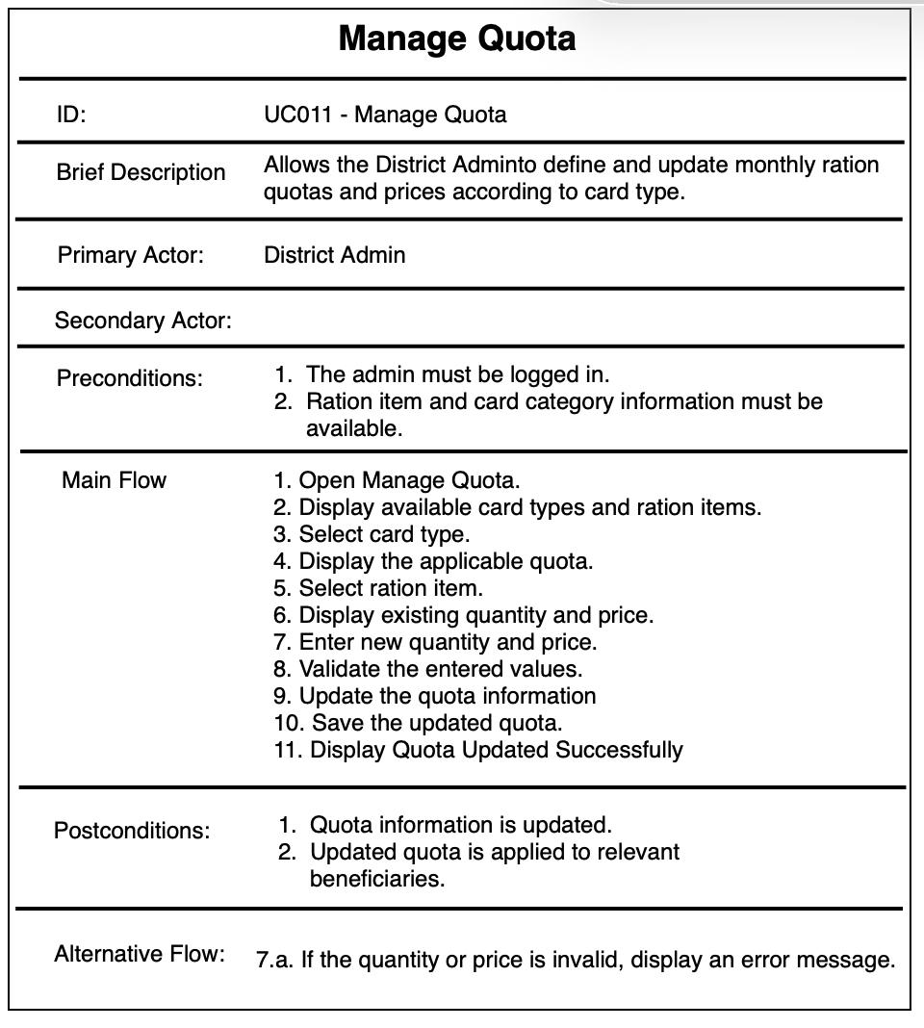
Use Case Specification
E-Ration Management System | Project
18

Slide 25
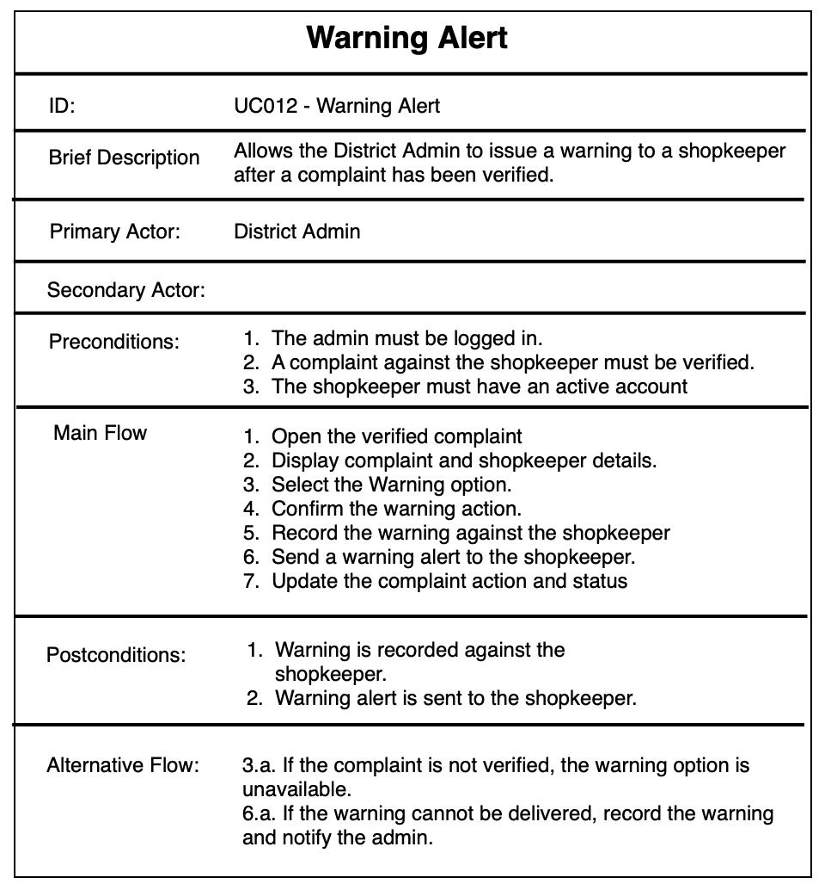
Use Case Specification
E-Ration Management System | Project
18

Slide 26
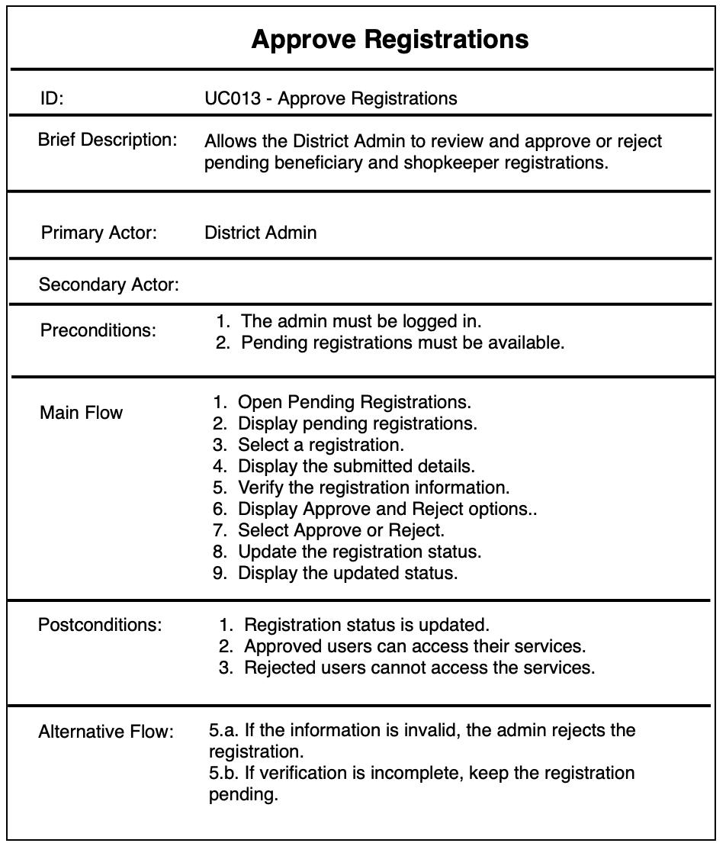
Use Case Specification
E-Ration Management System | Project
18

Slide 27
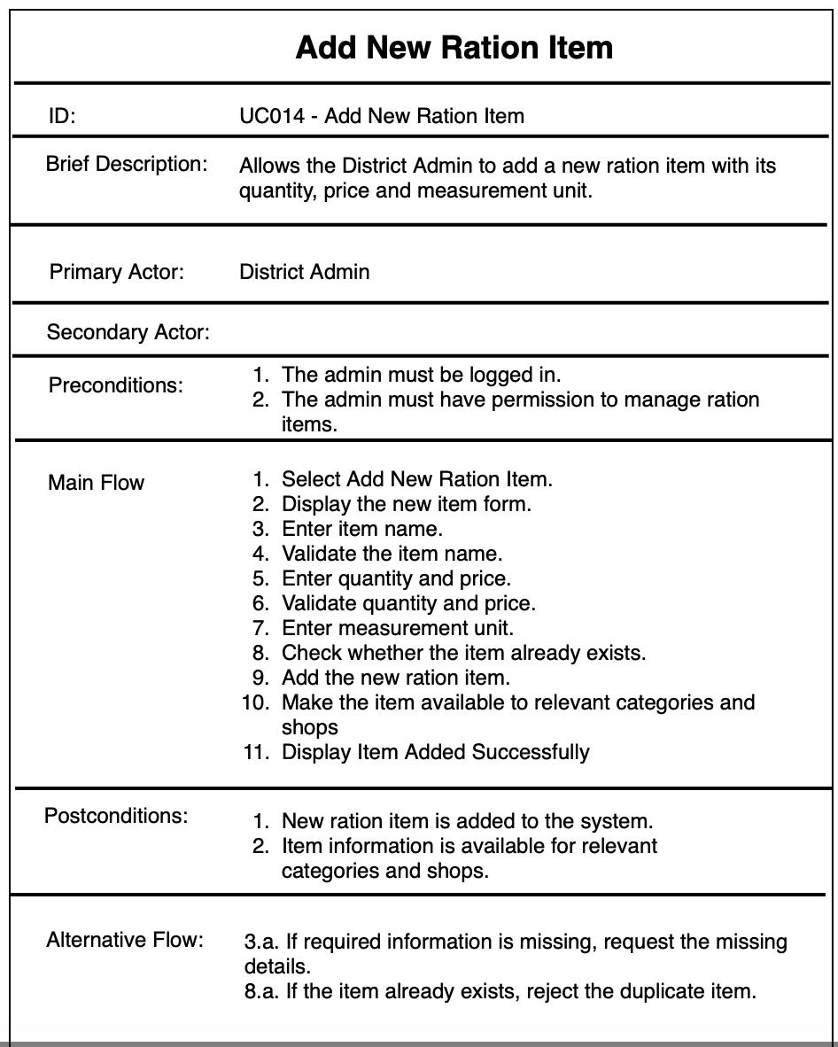
Use Case Specification –
E-Ration Management System | Project
18

Slide 28
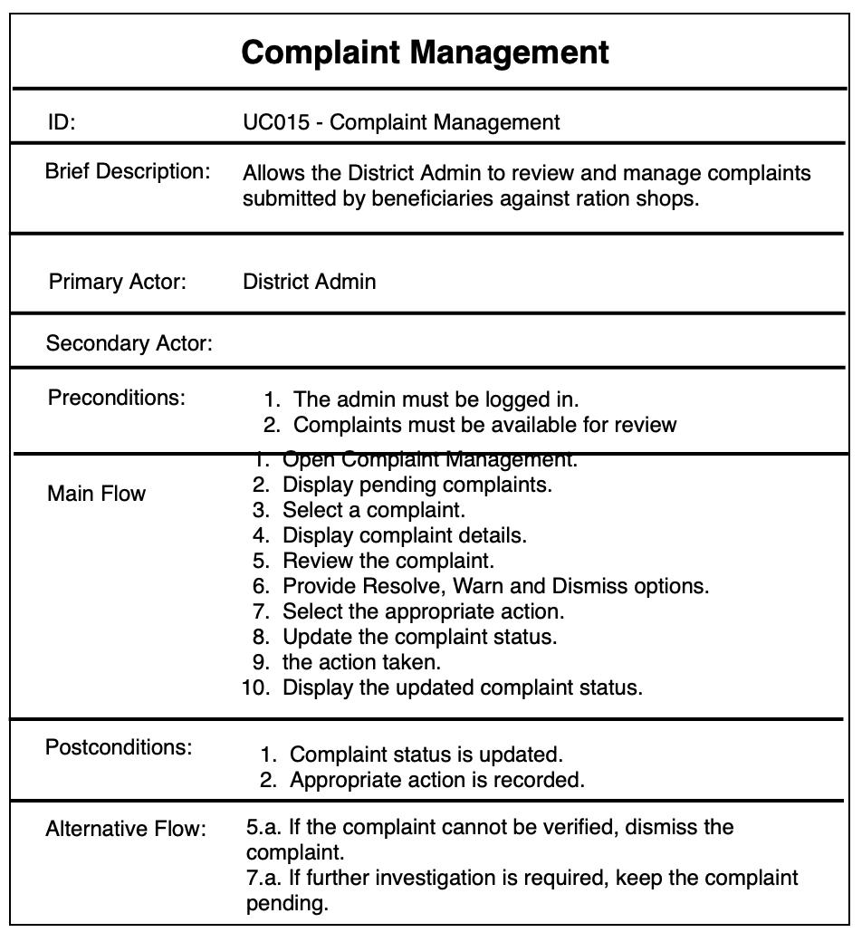
Use Case Specification
E-Ration Management System | Project
18

Slide 29
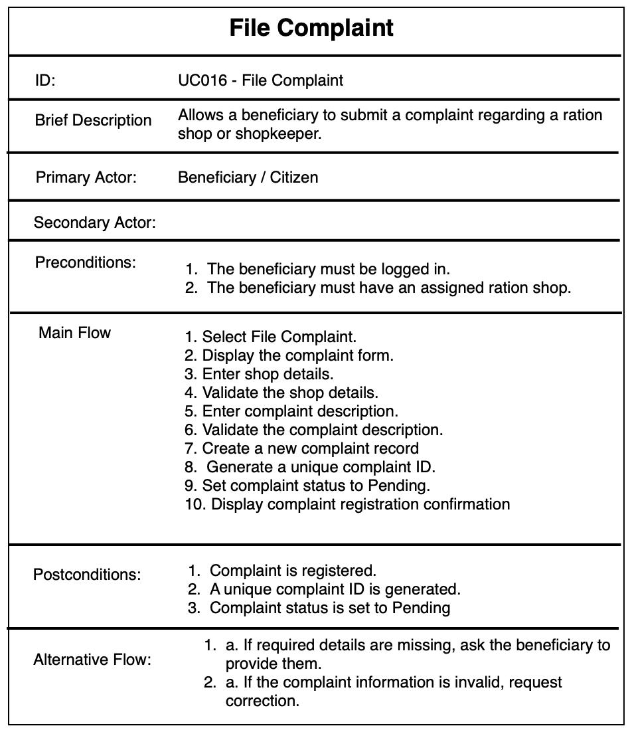
Use Case Specification
E-Ration Management System | Project
18

Slide 30
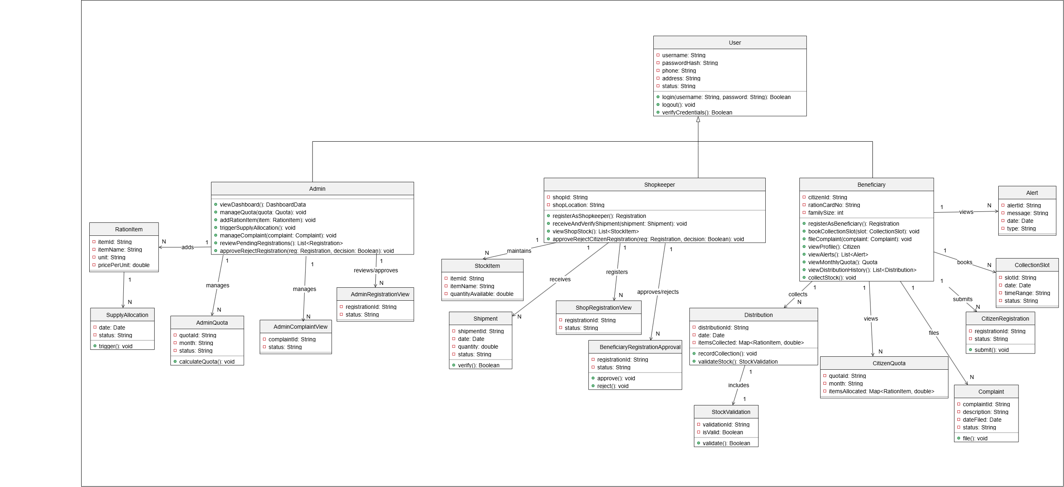
System Design – Class Diagram
E-Ration Management System | Mini Project
19

Slide 31
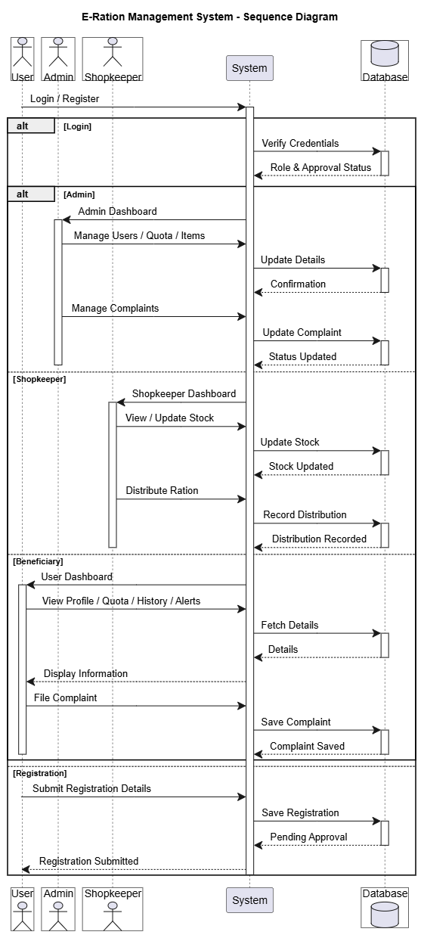
System Design – Sequence Diagram
E-Ration Management System | Mini Project
20

Slide 32
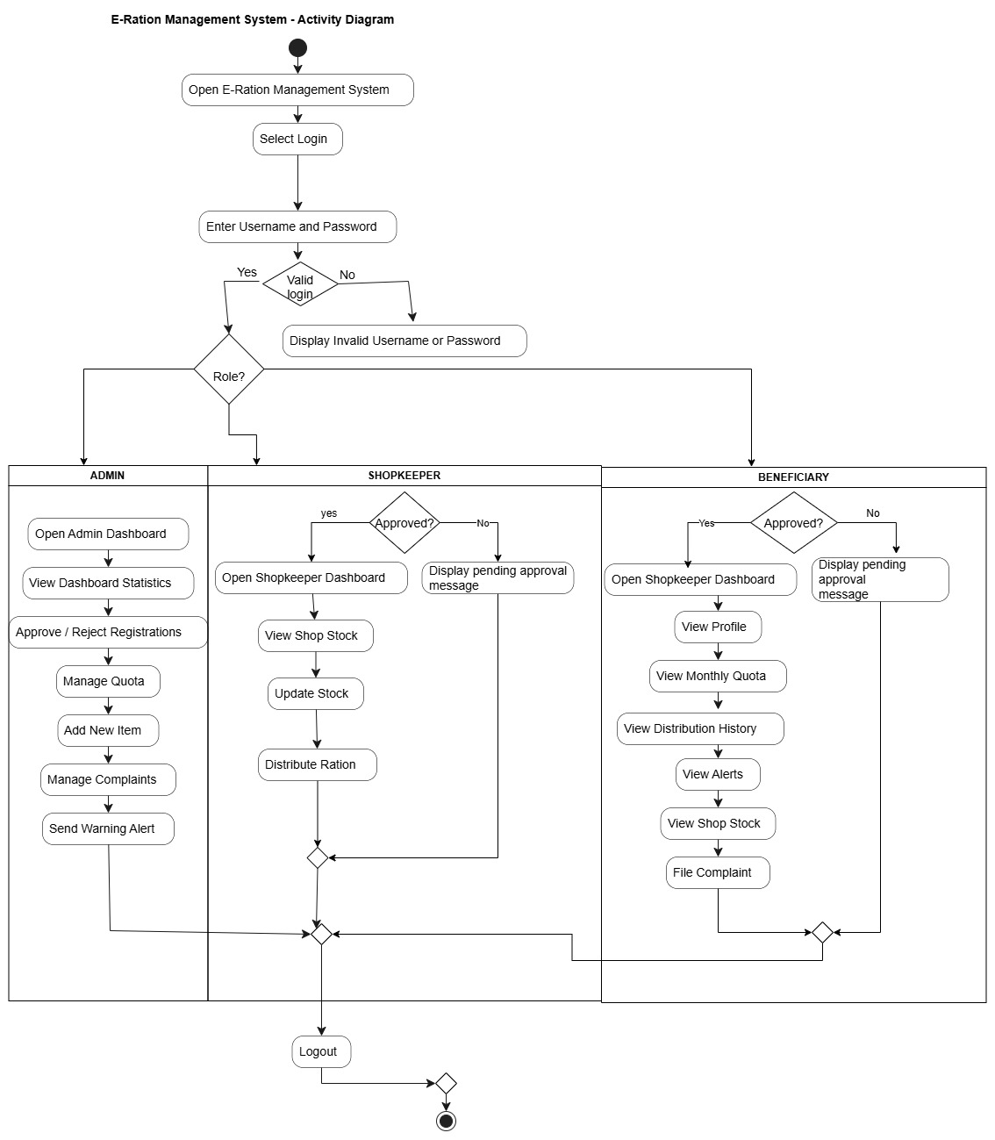
System Design – Activity Diagram
E-Ration Management System | Mini Project
21

Slide 33
Conclusion
The E-Ration Management System provides a centralized platform for digital ration management.
It supports role-based operations for Admin, Shopkeeper and Beneficiary.
Registration, approval, quota, stock and distribution can be managed systematically.
Complaint and alert features support communication and monitoring.
The system aims to reduce manual effort and maintain consistent digital records.
E-Ration Management System | Mini Project
22

Slide 34
References
Project Functional and Non-Functional Requirements Document.
PHP Documentation – Server-side application development.
MySQL Documentation – Database management and SQL.
PlantUML Documentation – UML diagram preparation.
Project design and implementation resources.
E-Ration Management System | Mini Project
23

